Slide 1
ELDER JUSTICE LUNCH AND LEARN COLLABORATION AND THE FUTURE OF ELDER JUSTICE
Preventing Eviction in the Age of COVID-19

Slide 2
Welcome & Introductions
Nicole Howell (Facilitator)
Executive Director
Ombudsman Services of Contra Costa, Solano, and Alameda

Slide 3
YOUR TOOLBOX…
Type in your question or comment
Connect with speakers and other participants using the chat

Slide 4
ACCESSIBILITY
Enable captions by selecting the icon on your toolbar
(NEW!) ASL available via Zoom video feed

Slide 5
Elder Justice Lunch and Learn Series
Mark your calendars for the third Thursday of every month from June 18, 2020, to May 20, 2021. Each session is scheduled from 12 to 1 PM PST.
*December’s webinar will be held on the second Thursday of the month, December 10th.

Slide 6
Ombudsman Services Logo Slide

Slide 7
Series Partners
Sponsor
Planning Partners

Slide 8
Homelessness in California
40,000 people age 65 and older were homeless in 2017
The number of homeless people 62 and older jumped 68.5% across the United States from 2007-2017
44% of all homeless people over 50 years of age hit the streets for the first time after turning 50

Slide 9
Preventing Eviction in the Age of COVID-19
Ollie Ehlinger
Managing Attorney
Legal Services of Northern California, Solano

Slide 10
Intro to Legal Services of Northern California
Non-profit law firm that provides free civil legal advice, advocacy, and representation to low-income and elderly residents.
If we can’t help an individual, we will try to find a referral.

Slide 11
Evictions in the Age of COVID
Agenda:
Eviction Procedure (Notice, Pre-Judgment, and Post-Judgment periods).
COVID-Related Changes to the Procedure.

Slide 12
Important Note
There is no eviction “moratorium” in California. There are various pauses and protections in place, but renters can be (and are being) evicted right now.

Slide 13
Eviction Procedure
Eviction is the legal process by which the owner of a rented property removes a renter from the property. The owner must terminate the renter’s right to occupy the property (the Notice period), commence and prevail in a lawsuit in Court (Pre-judgment period), and schedule a time for the Sheriff to remove the renter (Post-judgment period) to fully remove the renter.

Slide 14
Eviction Procedure
Being able to identify what part of the process a renter is
currently in allows you to:
1. Determine if the renter has a right to remain; and if not,
2. Determine how much time the renter has to move.

Slide 15
Notice Period I
Notice Period
An owner must serve a proper termination notice to end a renter’s right to occupy a rented premises.
Questions to ask:
Can the renter fix the issue raised in the notice?
Is this a proper notice?

Slide 16
Notice Period II
Notice Period
Can the renter fix this notice?
3 Day Notice to Pay Rent or Quit: The renter must pay rent in the exact amount and the exact method listed in the notice before the end of the 3rd day.
3 Day Perform Covenants or Quit: The renter must stop the specified lease violation by the end of the 3rd day.

Slide 17
Notice Period III
Notice Period
Is this Notice valid?
3 Day Notice to Pay Rent or Quit: Does the notice demand an incorrect amount of rent? Is there a severe housing code defect?
3 Day Notice to Perform or Quit: Has the renter actually broken the lease term? Is the action actually demanded by/prohibited by the lease?

Slide 18
Notice Period IV
Notice Period
Is this Notice valid?
30/60/90 Day Notices
Is the timeframe correct?
A renter who has lived in a property for over a year is due a 60-day notice; a Section 8/Voucher tenant is due a 90-day notice.

Slide 19
Notice Period V
Notice Period
Is the Notice valid?
30/60/90 Day Notice:
Does the owner have to provide cause?

Slide 20
Notice Period VI
Notice Period
Which renters are entitled to good cause?
Renters in federally-subsidized properties;
Mobile home owners/Long-term RV residents; and
Residents who have lived for over a year in multi-family housing built after 2005 or most corporately-owned single family homes.

Slide 21
Notice Period VII
Notice Period
Review:
The Notice period allows the renter to either reinstate/”save” their tenancy or know the timeframe before the property owner can file a Court action.

Slide 22
Prejudgment Period I
Prejudgment Period
The first business day after the period in the Notice ends, the owner may file a lawsuit (called an Unlawful Detainer or “UD”) to remove the renter.
The owner must have someone over 18 serve the renter with the UD paperwork.
Once served, the renter has five days to file papers at Court to respond.
If the renter does not respond, the owner may take judgment by default.

Slide 23
Prejudgment Period II
Prejudgment Period
https://www.courts.ca.gov/documents/sum130.pdf

Slide 24
Prejudgment Period III
Prejudgment Period
The renter’s response contains the renter’s defenses to the UD.
“I don’t owe all the rent alleged in the notice because the owner never fixed my broken heater.”
“The 30-Day Notice is incorrect because I have lived at the property for over 5 years.”

Slide 25
Prejudgment Period IV
Prejudgment Period
Once the Court receives the renter’s response, the owner may ask for a trial date, which (PRIOR TO COVID) the Court set within 20 days.
At anytime before the Court date, the renter is able to move out of the property or reach a settlement with the owner to avoid an eviction judgment on their credit/renter report.

Slide 26
Prejudgment Period V
Prejudgment Period
If the renter has not moved out or reached a settlement, the renter must present their case at trial. The Court never grants continuances. The renter should have all their evidence (such as receipts, Code Enforcement reports, witnesses) ready of the day of Court.
If the Court rules for the renter, the tenancy continues uninterrupted.
If the Court rules for the owner, the Post-Judgment period begins.

Slide 27
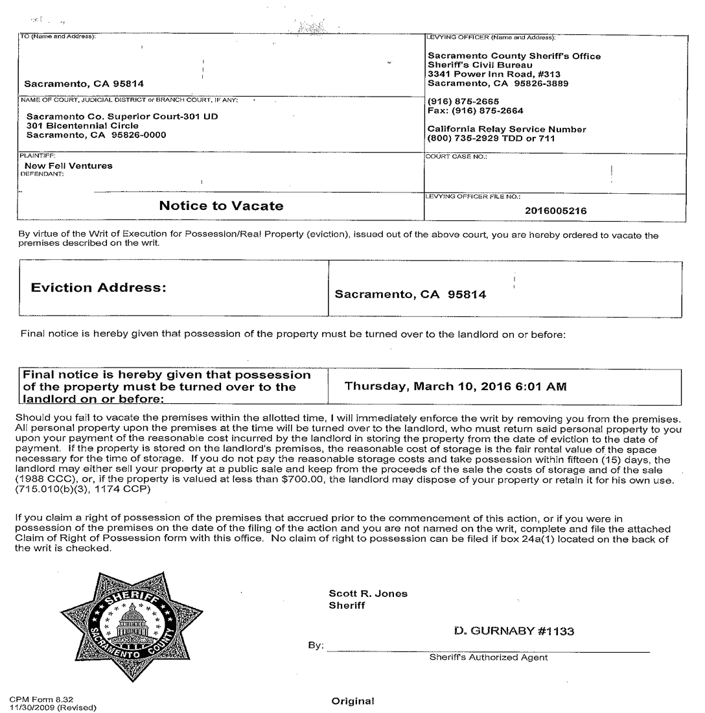
CPM Form 8.32 (Final Eviction Notice)

Slide 28
Post-judgment period I
Post-judgement period
Applies to a renter who did not respond after being served, lost at trial, or violated the terms of a court-enforceable settlement.
The owner receives the right to request the Sheriff perform a lockout.
The Sheriff posts a Notice to Vacate on the property at least 5 days (generally 7 days) prior to the lockout.

Slide 29
Post-judgment Period II
Post-judgement period
To postpone a lockout, a renter may ask for a Stay of Execution from the Court, but the renter must show the lockout will cause “extreme hardship” and be able to pay the rent for the period of the stay.
The Court has complicated rules to request a Stay of Execution.
The owner must store any personal items left in the property after the lockout for 15 days.

Slide 30
COVID Changes to Eviction Procedure I
COVID-19 Changes to Eviction Procedure
There is no eviction “moratorium” in California. There are various pauses and protections in place, but renters can be (and are being) evicted right now.

Slide 31
COVID Changes to Eviction Procedure II
COVID-19 Changes to Eviction Procedure
Actions by the Judicial Council:
After April 17, An owner may not serve a UD unless the UD is “necessary to protect the public health and safety” until 90 days after the Governor ends the State of Emergency.
No set definition for “public health and safety” but should not include periodic termination, non-payment, or minor lease violations.

Slide 32
COVID Changes to Eviction Procedure III
COVID-19 Changes to Eviction Procedure
Actions by the Judicial Council:
This pause is likely to be repealed or replaced by state legislation.

Slide 33
COVID Changes to Eviction Procedure IV
COVID-19 Changes to Eviction Procedure
Actions by Congress:
Through the CARES Act, Congress has banned evictions for non-payment of rent (regardless why the renter could not pay) in federally-subsidized properties through July 27.
The Judicial Council rules would pause these evictions anyway.

Slide 34
COVID Changes to Eviction Procedure V
COVID-19 Changes to Eviction Procedure
Actions by the Governor:
Banned rental increases over 10%.
Allowed local jurisdictions to pause evictions based on COVID-related non-payment of rent.

Slide 35
COVID Changes to Eviction Procedure VI
COVID-19 Changes to Eviction Procedure
Actions by the California Legislature:
None.
There is pending legislation to prohibit evictions for COVID-paused non-payment of rent (or turn rent for that period into a “consumer debt”).

Slide 36
COVID Changes to Eviction Procedure VII
COVID-19 Changes to Eviction Procedure
Actions by Solano County:
Prohibited evictions for COVID-caused non-payment of rent during the State of Emergency.
These evictions are currently paused by the Judicial Council.

Slide 37
COVID Changes to Eviction Procedure VIII
COVID-19 Changes to Eviction Procedure
Takeaway:
Pre-COVID eviction timeline: Notice period + 5-6 weeks.
During COVID eviction timeline for most minor lease violations: paused indefinitely.

Slide 38
CONTACT
Ollie Ehlinger
Email: oehlinger@lsnc.net
Phone: (707) 643-0054

Slide 39
Q&A DISCUSSION
Type in your question or comment
Connect with speakers and other participants using the chat

Slide 40
REGISTRATION NOW OPEN!
JOIN US for Session #3 – August 20, 2020
National Trends in Adult Protective Services During COVID-19
Lori Delagrammatikas
Executive Director
National Adult Protective Services Association
Advocating for Elder Justice in the COVID-19 Era
Lisa Nerenberg
Executive Director
California Elder Justice Coalition

Slide 41
Thank you!

